Slide 1

A Mini Project Presentation on
ONLINE VOTING SYSTEM
Presented by:
V SATHYADEVA (18N31A12H3) S SRAVAN KUMAR (18N31A12F7) U BRAHMA TEJA (18N31A12G9)
2018-2022
Under the guidance of
Mrs. K SWETHA
Associate Professor
Department of information technology
MALLA REDDY COLLEGE OF ENGINEERING & TECHNOLOGY
(Autonomous Institution – UGC, Govt. of India)
(Affiliated to JNTUH, Hyderabad, Approved by AICTE - Accredited by NBA & NAAC – ‘A’ Grade
– ISO 9001:2015 Certified)

Slide 2
AGENDA
Introduction
Methodology
Implementation
Conclusion
References
2

Slide 3
INTRODUCTION
In our Online Voting System people who have citizenship of India and whose age is above 18 years and any gender can give his\her vote without going to any physical polling station. There is a database which is maintained in which all the details of voters and administrators with complete information is stored.
In “ONLINE VOTING SYSTEM” a voter can use his\her voting right online without any difficulty. He/She has to be registered first for him/her to vote. The system Administrator registers the voters on a special site of the system visited by him only by simply filling registration form to register voter. After the validity of them being citizens of India had confirmed by the system administrator by comparing their details submitted with those in existing databases such as those as the Registrar of Persons, the citizen is then registered as a voter.
3

Slide 4
EXISTING SYSTEM
The Voter has to visit polling booths to Vote a Candidate so there is wastage of time.
All the information of the Voter or Candidate is to be filled in manually.
There are Electronic Voting Machines used which Takes More Cost.
The Voter has to manually register into the Voter List. Also Vote counting has to be done manually.
All the Information of the Voter or Candidate is to be filling in manually. Voter must be present in his/her Constituency to give his/her Vote.
2017
4

Slide 5
PROPOSED SYSTEM
To reduce a lot of time, this Online Voting System will manage the Voters information by which voter can login and cast his/her vote from anywhere through our web page.
At the time of registration voter will be asked for Full name, age, mobile no. email id, and verified the details by the administrator. There is no need to do the process manually, everything is done in online.
In this pandemic time, it is high risk to go out to polling booths to cast our vote, so to ensure the safety of the voters, our voting portal can be used from anywhere.
As a great feature, our voting portal records the vote casted, counting and presents the results through online only.
Then voter will be authenticated, and he can give vote from one of the candidate from the list.
5

Slide 6
SYSTEM REQUIREMENTS
SOFTWARE REQUIREMENTS:017
MYSQL DBMS
HTML
PHP
Java Script
XAMPP
Web Browser
Bootstrap
6

Slide 7
HARDWARE REQUIREMENTS:
•Microsoft Windows XP Professional SP3/Windows 7 Professional/Windows10 :
• Processor : 800MHz Intel Pentium III or equivalent
• Memory : 10 GB
• Disk space : 750 MB of free disk space
•Ubuntu 9.10 :
Processor : 800MHz Intel Pentium III or equivalent
• Memory : 10 GB
• Disk space : 650 MB of free disk space
7

Slide 8
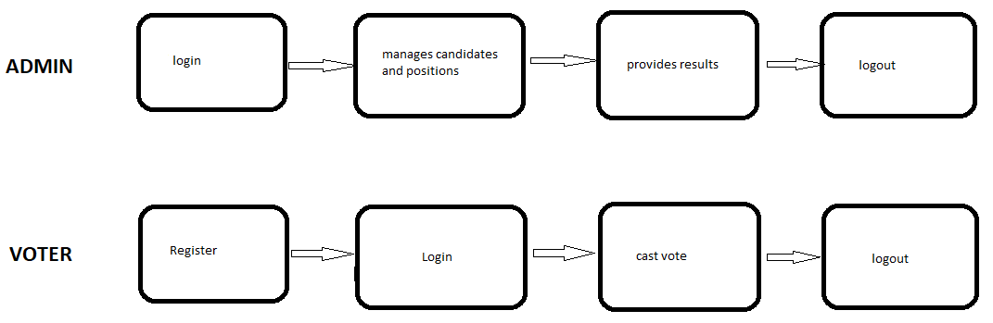
METHODOLOGY
Every voter will be provided by a login access after registration as voter. This login process will be automatically checked along with the ID stored on the database. If both the information matches with the database documentation then only further he will be authorized for voting else he cannot login in our system.To achieve the rules of supreme Electoral Council as follow: Only eligible persons vote, No person is allowed to vote more than once and at more than one place. The vote is secret, and each vote gets counted and to achieve the aims of online voting as follow: increase participation, lower the cost of running election, and improve the accuracy of results.
8

Slide 9
MODULES
Admin
Administrator interface consists of login name and unique password using which admin can login into the online voting system. Administrator has the main control of the system.
Voter
Voter interface consists of a login name and unique password using which he/she can login into the online voting system. This will be supplied by the administrator to the user. Once the user has logged in, he/she has the privilege to view the names of candidates listed by the administrator,
view the results after the termination date of the election.
9

Slide 10
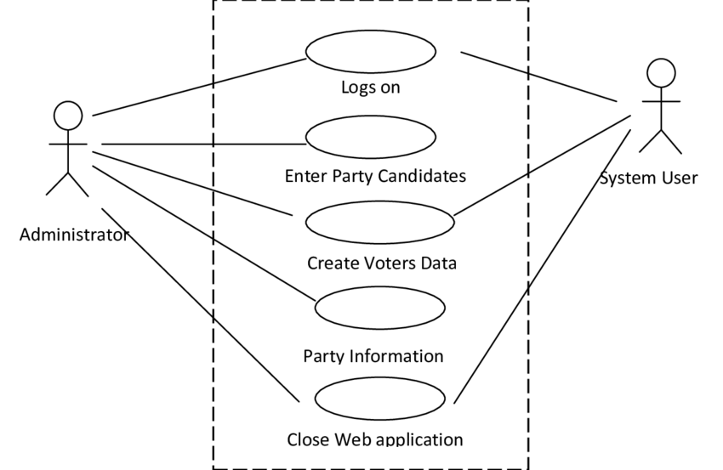
UML DIAGRAM
2017
10

Slide 11
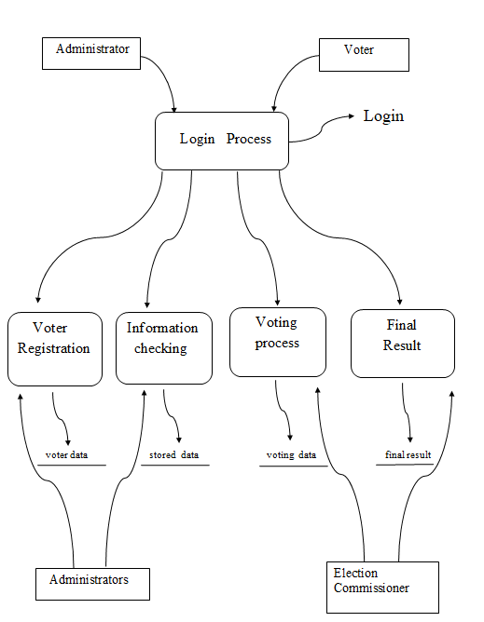
DATA FLOW DIAGRAM
2017
2016
201
11

Slide 12
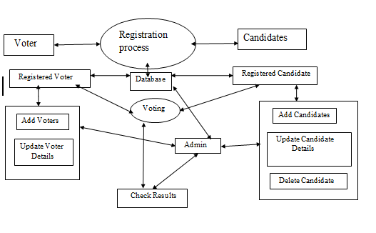
ER DIAGRAM
2017
2016
201
12

Slide 13
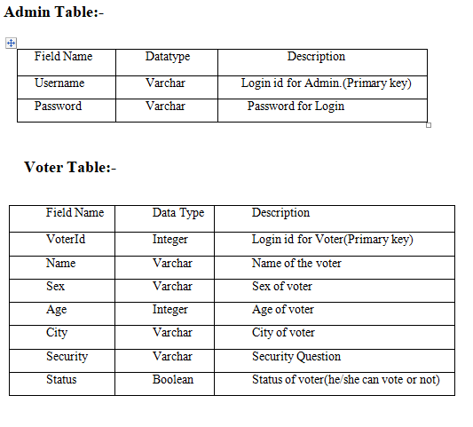
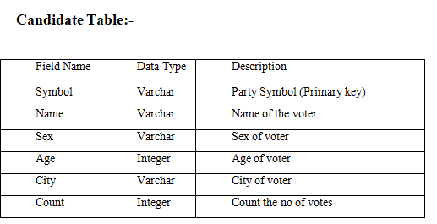
DATABASE TABLES
2015
2017
2019
2016
201
13

Slide 14
IMPLEMENTATION
login.html :
<html> <head> <link href="css/admin_styles.css" rel="stylesheet" type="text/css" /> <script language="JavaScript" src="js/admin.js"></script> </head><body bgcolor="tan"> <center><a href ="https://sourceforge.net/projects/pollingsystem/"><img src = "images/logo" alt="site logo"></a></center><br><center><b><font color = "brown" size="6">Welcome to Online Voting Portal</font></b></center><br><br> <div id="page"> <div id="header"> <h1>Administrator Login </h1> <p align="center"> </p></div> <div id="container"> <table width="300" border="0" align="center" cellpadding="0" cellspacing="1" bgcolor="#FFFFFF"> <tr> <form name="form1" method="post" action="checklogin.php" onsubmit="return loginValidate(this)"> <td><table width="100%" border="0" cellpadding="3" cellspacing="1" bgcolor="tan"> <tr><td width="78">Username/Email</td>
14

Slide 15
<tr>
<td width="6">:</td> <td width="294"><input name="myusername" type="text" id="myusername"></td> </tr> <tr> <td>Password</td> <td>:</td> <td><input name="mypassword" type="password" id="mypassword"></td> </tr> <tr> <td> </td> <td> </td> <td><input type="submit" name="Submit" value="Login"></td> </tr> </table> </td></form></tr> </table> </div> </div> </body> </html>
15

Slide 16
voter.html :
<html>
<head>
<link href="css/user_styles.css" rel="stylesheet" type="text/css" />
<script language="JavaScript" src="js/user.js">
</script>
</head><body bgcolor="tan">
<center><a href ="https://sourceforge.net/projects/pollingsystem/"><img src = "images/logo" alt="site logo"></a>
</center><br>
<center><b><font color = "brown" size="6">Welcome to Online Voting Portal</font></b></center><br><br>
<div id="page">
<div id="header">
<h1>Student Login </h1>
<div class="news"><marquee>New polls are up and running. But they will not be up forever! </marquee></div>
</div>
<div id="container">
<table width="300" border="0" align="center" cellpadding="0" cellspacing="1" bgcolor="#FFFFFF">
<tr>
<form name="form1" method="post" action="checklogin.php" onsubmit="return loginValidate(this)">
<td> <table width="100%" border="0" cellpadding="3" cellspacing="1" bgcolor="tan">
16

Slide 17
<td width="78">Username/Email</td> <td width="6">:</td> <td width="294"><input name="myusername" type="text" id="myusername"></td></tr> <tr> <td>Password</td> <td>:</td> <td><input name="mypassword" type="password" id="mypassword"></td></tr> <tr><td><input type="submit" name="Submit" value="Login"></td> </tr> </table></td> </form> </tr> </table> <center> <br>Not yet registered? <a href="registeracc.php"><b>Register Here</b></a> <br>Return to <a href="http://www.anu.ac.ke"><b>ANU Home Page</b></a> </center></div> </div> </body> </html>
17

Slide 18
admin.php :
<?php session_start(); require('../connection.php'); if(empty($_SESSION['admin_id'])){ header("location:access-denied.php"); } ?> <html><head> <link href="css/admin_styles.css" rel="stylesheet" type="text/css" /> </head><body bgcolor="tan"> <center><a href ="https://sourceforge.net/projects/pollingsystem/"><img src = "images/logo" alt="site logo"></a></center><br> <center><b><font color = "brown" size="6">Welcome to Online Voting Portal</font></b></center><br><br> <div id="page"> <div id="header"> <h1>ADMINISTRATION CONTROL PANEL </h1> <a href="admin.php">Home</a> | <a href="positions.php">Manage Positions</a> | <a href="candidates.php">Manage Candidates</a> | <a href="refresh.php">Poll Results</a> | <a href="manage-admins.php">Manage Account</a> | <a href="change-pass.php">Change Password</a> | <a href="logout.php">Logout</a> </div><p align="center"> </p><div id="container"> <p>Click a link above to perform an administrative operation.</p></div></div></body></html>
18

Slide 19
logout.html : <html> <head> <link href="css/admin_styles.css" rel="stylesheet" type="text/css" /> </head> <body bgcolor="tan"> <center><b><font color = "brown" size="6">Welcome to Online Voting Portal</font></b></center><br><br> <div id="page"> <div id="header"> <h1>Logged Out Successfully </h1> <p align="center"> </p> </div> <? session_start(); session_destroy(); ?> You have been successfully logged out of your control panel.<br><br><br> Return to <a href="login.html">Login</a> </div> </body> </html>
19

Slide 20
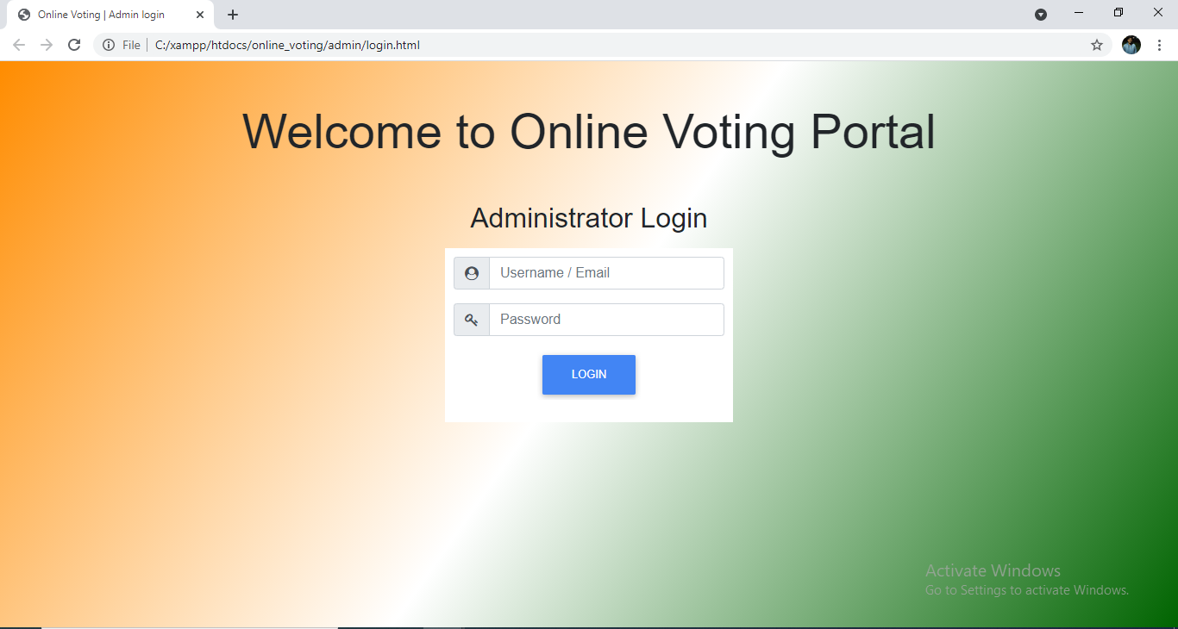
RESULTS
Admin Login Page:
2015
2017
2019
2016
20

Slide 21
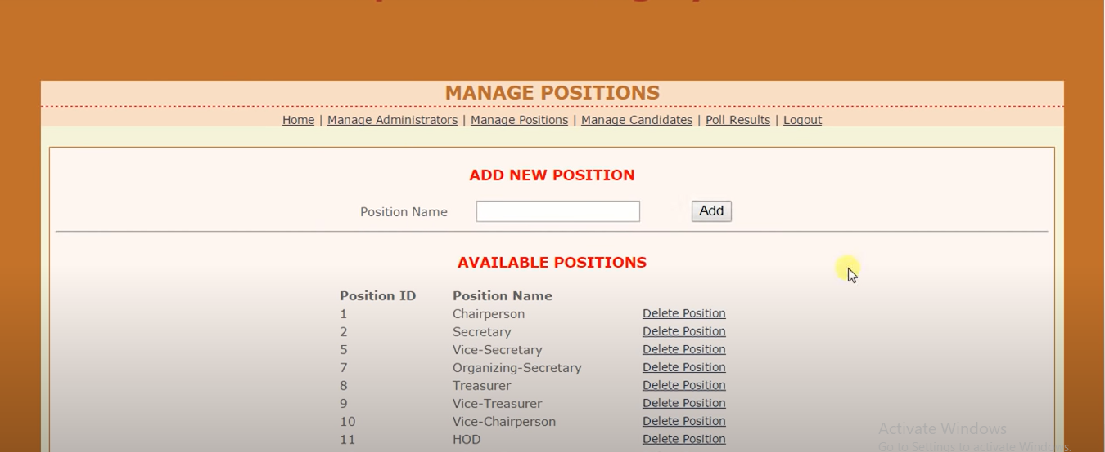
21

Slide 22
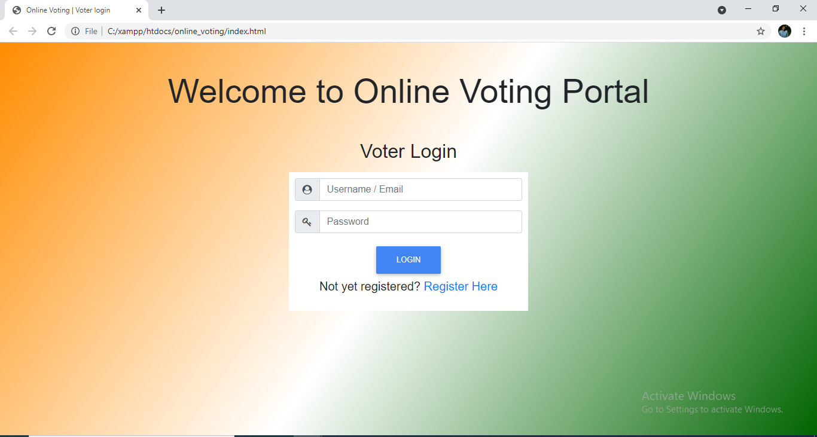
Voter Login Page:
2015
2017
2019
2016
22

Slide 23
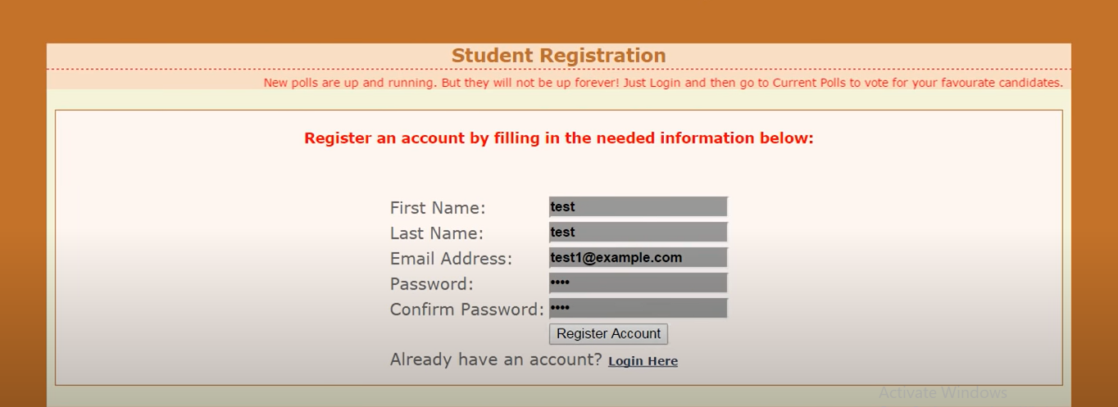

Slide 24
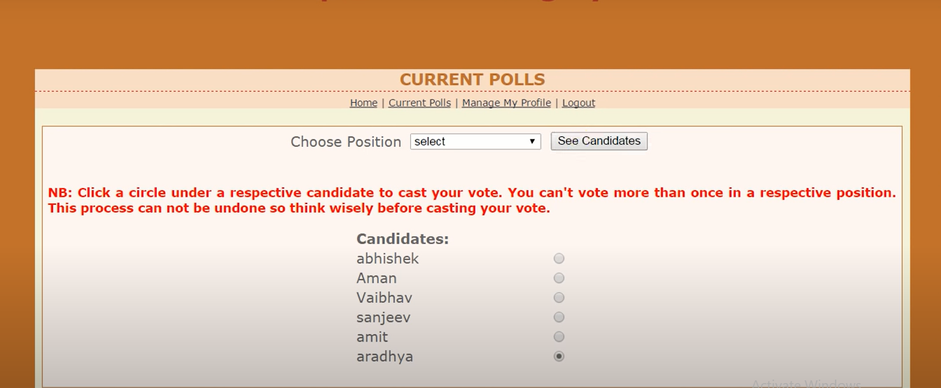
23

Slide 25
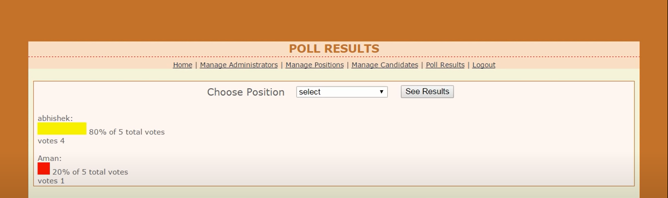
24

Slide 26
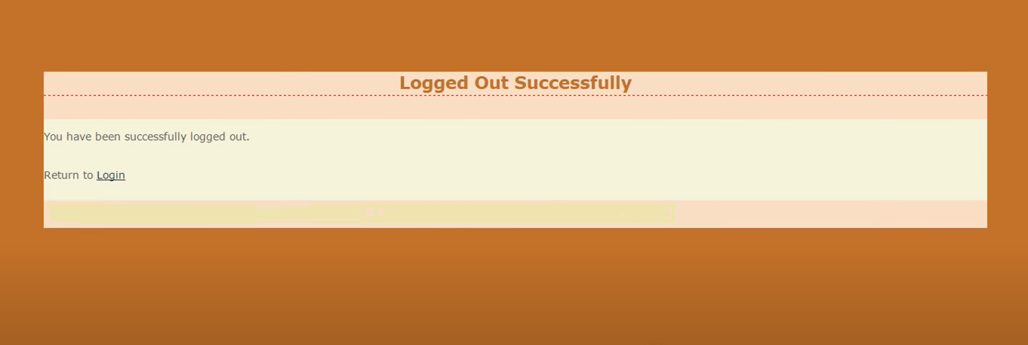
25

Slide 27
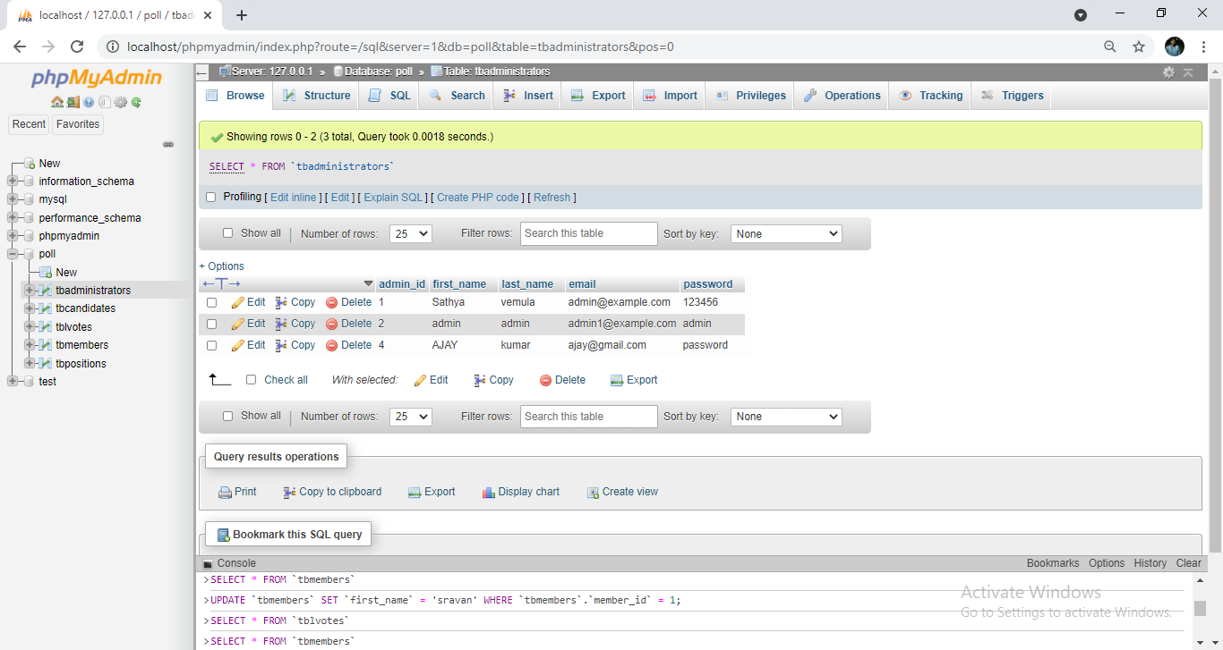
DATABASE

Slide 28
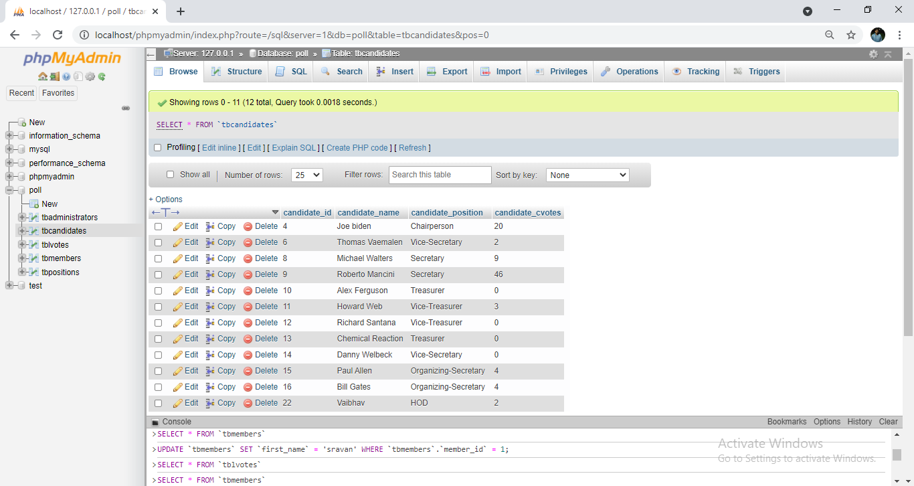
DATABASE

Slide 29
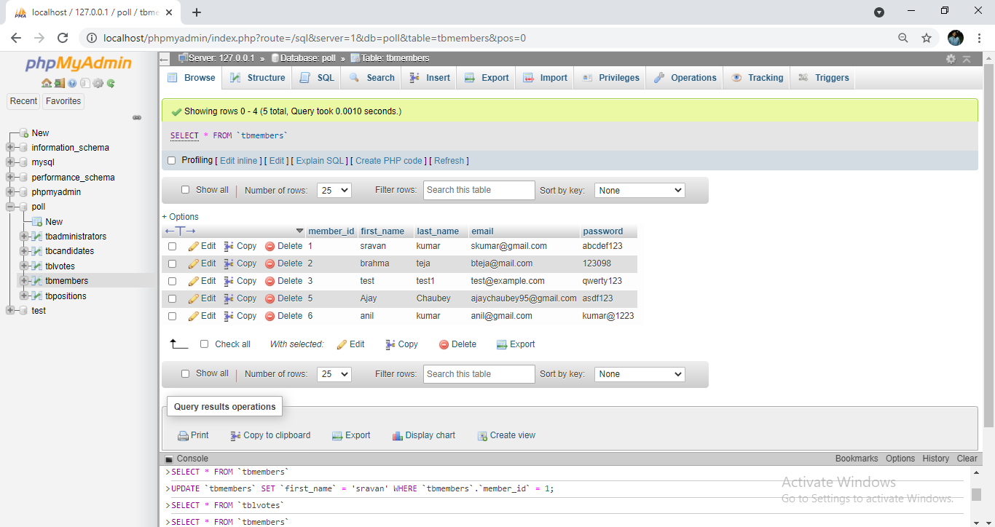
DATABASE

Slide 30
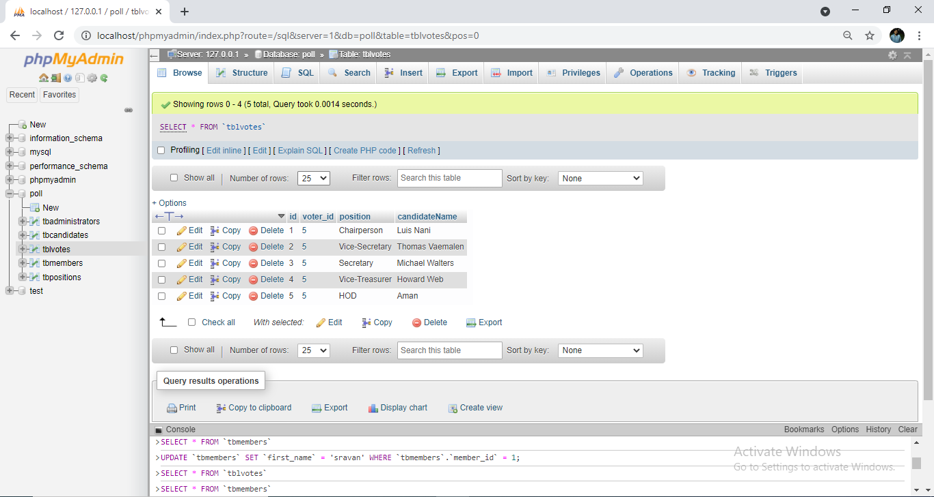
DATABASE

Slide 31
CONCLUSION
This Online Voting system will manage the Voter’s information by which voter can login and use his voting rights. The system will incorporate all features of voting system. It provides the tools for maintaining voter’s vote to every party and it count total no. of votes of every party.
In this user who is above 18 year’s register his/her information on the database and when he/she want to vote he/she has to login by his id and password and can vote to any party only single time. Voting detail store in database and the result is displayed by calculation. By online voting system percentage of voting is increases. It decreases the cost and time of voting process. It is very easy to use and It is vary less time consuming. It is very easy to debug.
2017
26

Slide 32
FUTURE SCOPE
The Online Voting System platform can be made more secure by using the following methods
Aadhaar Id access.
• Password Changing.
• Finger print detection.
• Cornea Detection.
The password used by the user to vote is provided by the administrator. In the future the user can be
given the privilege of changing the password. So it helps to increase the security of the system. The
other two methods that can be used are cornea detection and fingerprinting. But here the problem is
that it decreases the scope of the platform because these systems need some electronic components
so implement. So it will avoid the users privilege to cast the votes at their fingertips.
27

Slide 33
REFERENCES
[1] Tadayoshi Kohno, Adam Stubblefield, Aviel D.Rubin, Dan S. Wallach,“Analysis of an Electronic
Voting System”, John Hopkins University Information Security Institute Technical Report, TR-2018-19,
July 23,2018 .
[2] David L. Dill, Bruce Schneier, and Barbara Simons, “Voting and technology: Who gets to count your
vote?”, Communications of the ACM, vol. 46(8), Aug. 2003, pp. 29–31.
[3] David Jefferson, Aviel D. Rubin, Barbara Simons, and David Wagner, “Analyzing Internet voting
security”,
Communications of the ACM, vol. 47(10), Oct. 2004, pp. 59–64.
2017
28

Slide 34
THANK YOU

